Slide 1
Calculating Subnet Masks

Slide 2
Calculating Subnets
Subnetting alters the rules of classful IPv4 addressing and is called classless addressing
To subnet a network, you borrow bits that would represent host information in classful addressing
Use those bits instead to represent network information
By doing so, you increase the number of bits available for the network ID (increase the number of networks)
You also reduce the number of bits available for identifying hosts (decrease number of hosts per network)

Slide 3
Subnet Mask Tables
Class A, class B, and class C networks can all be subnetted
Each class has a different number of host information bits that can be used for subnet information
The number of hosts and subnets on your network will vary depending on your network class and the way you use subnetting

Slide 4
Subnetting
To create subnets, we reassign (or “borrow) host bits as network bits
We always start at the leftmost host bit
Suppose we wish to subnet class C network address 192.168.10.0
we might borrow two host bits to create subnets
11000000.10101000.00001010.00000000
NNNNNNNN.NNNNNNNN.NNNNNNNN.HHHHHHHH
11000000.10101000.00001010.00000000
NNNNNNNN.NNNNNNNN.NNNNNNNN.SSHHHHHH

Slide 5
Subnetting
Two questions for subnetting:
How many subnets do you need?
How many hosts per subnet do you need?
If you borrow N bits for subnetting, and leave H bits for hosts, then you create:
2^{N} subnets, each consisting of 2^{H} addresses
2 of the addresses are unusable for hosts
The subnet address – host bits set to all 0
The broadcast address – host bits set to all 1

Slide 6
Subnetting
We also need to determine the subnet mask
We borrowed 2 bits from 192.168.10.0
24 network bits, 2 subnet bits, 6 host bits
NNNNNNNN.NNNNNNNN.NNNNNNNN.SSHHHHHH
So, the mask is
11111111.11111111.11111111.11000000
= 255.255.255.192 (note that 256 – 64 = 192)
More compactly: /26

Slide 7
IPv4 Subnet Calculation in Binary
Example: Create two subnet of network ID: 192.168.89.0 with an original subnet mask of 255.255.255.0
Steps to subnet:
1. Borrow from host bits
2. Determine the subnet mask
3. Determine the network IDs
4. Determine the ranges of IP addresses for hosts in the subnet

Slide 8
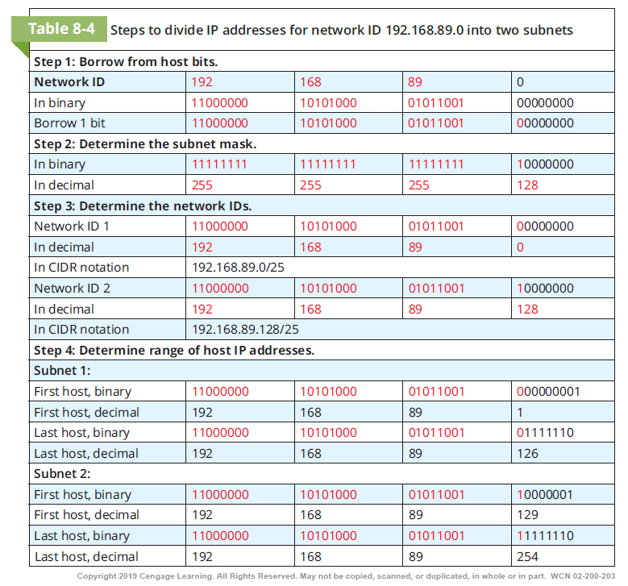

Slide 9
IPv4 Subnet Calculations Using Formulas
Steps to subnet a network ID of 192.168.89.0 into six subnets using formulas:
1. Decide how many bits to borrow
2. Determine the subnet mask
3. Calculate the network ID for each subnet
4. Determine the IP address range for hosts in each subnet
When calculating subnets, you’ll work with the following information:
Number of subnets
Number of host addresses per subnet
Network ID for each subnet
Broadcast address for each subnet
Range of possible host addresses within each subnet

Slide 10
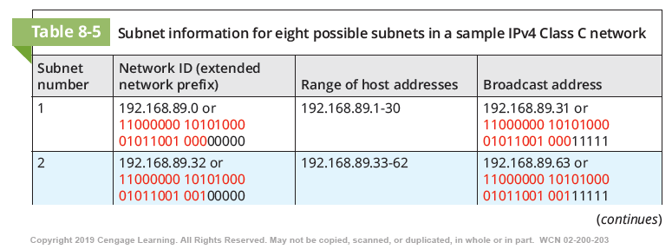

Slide 11
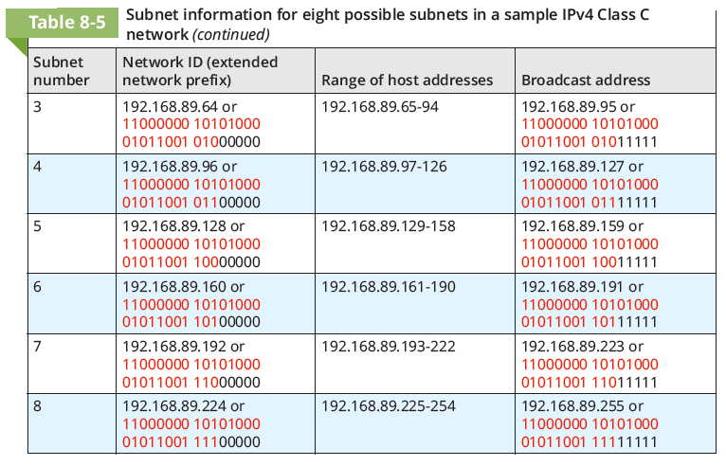

Slide 12
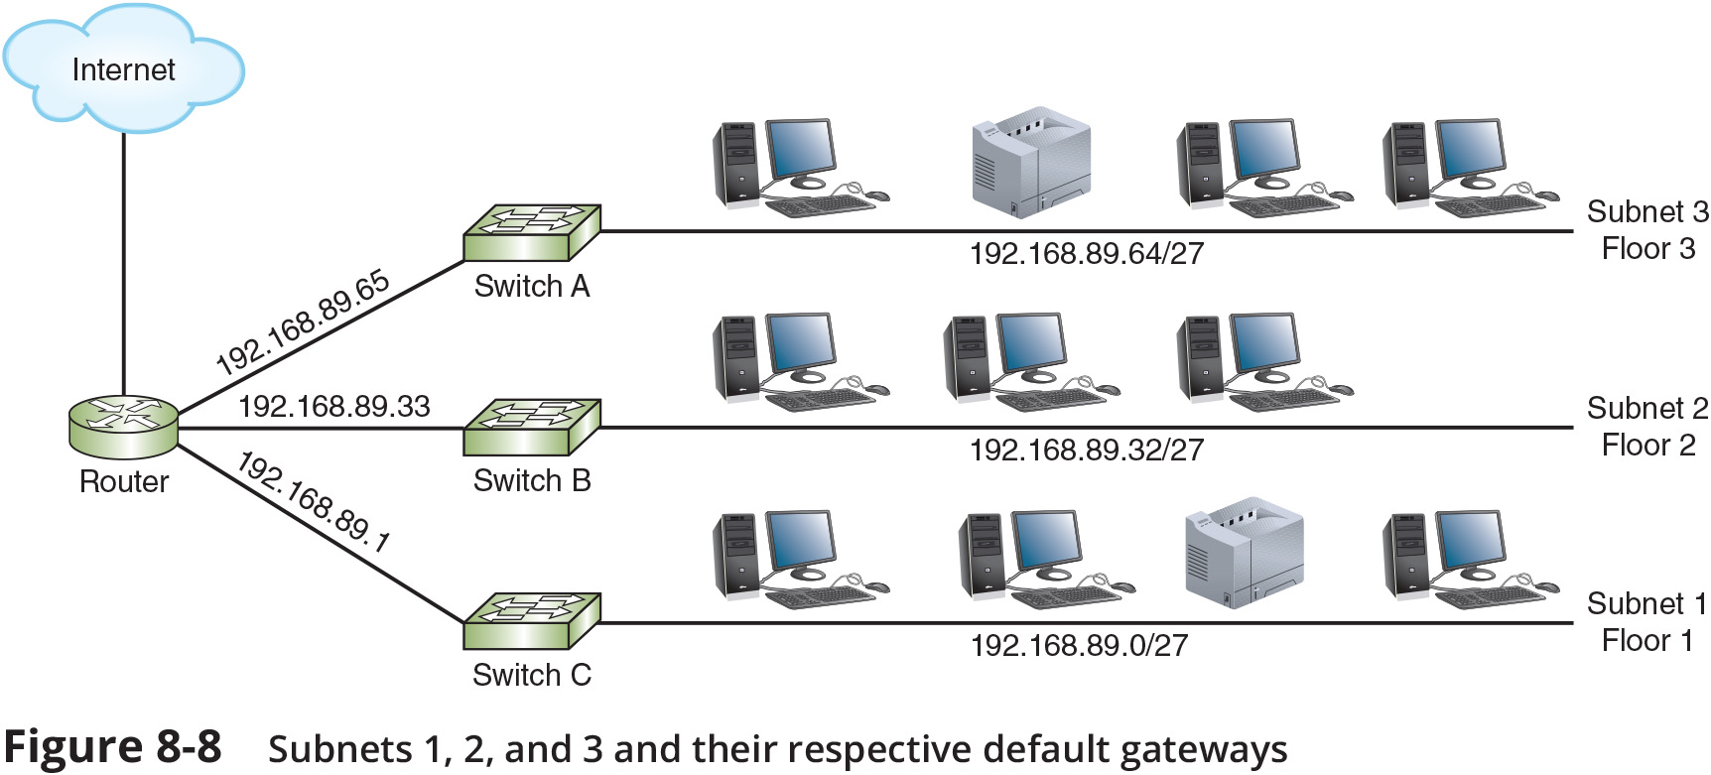
Implementing Subnets on a Network (1 of 3)

Slide 13
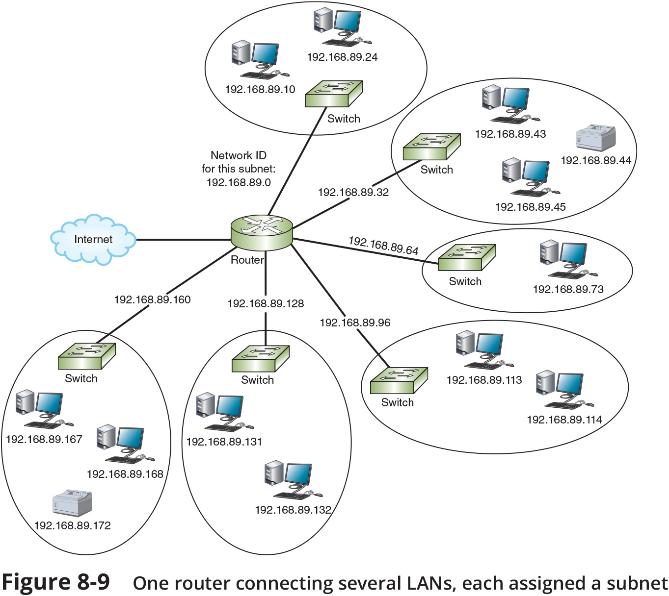
Implementing Subnets on a Network (2 of 3)

Slide 14
Implementing Subnets on a Network (3 of 3)
A centrally managed DHCP server can provide DHCP assignments to multiple subnets with the help of DHCP relay agent
A DHCP relay agent programmed to support UDP forwarding on port 67 receives the DHCP request from a client in one of its local broadcast domains
The relay agent repackages the message with the IP helper information and routes this transmission to its new destination in a different broadcast domain
The DHCP server notes the relay agent’s source interface IP address and assigns the DHCP client an IP address on the same subnet

Slide 15
Subnetting Example
So, if we borrow 2 bits for subnets, and leave 6 bits for hosts
We have 22 = 4 subnets
Each with 26 = 64 addresses
And 64 - 2 = 62 usable host addresses
Subnet # | Subnet ID | Broadcast ID | Host Range
0 | 192.168.10.0 | 192.168.10.63 | .1 - .62
1 | 192.168.10.64 | 192.168.10.127 | .65 - .126
2 | 192.168.10.128 | 192.168.10.191 | .129 - .190
3 | 192.168.10.192 | 192.168.10.255 | .193 - .254

Slide 16
Using the Subnet Mask to Extract the Subnet Address
Packet Address | 192.168.10.71 | 11000000.10101000.00001010.010 | 00111
Subnet Mask | 255.255.255.224 | 11111111.11111111.11111111.111 | 00000
Subnet Address | 192.168.10.64 | 11000000.10101000.00001010.010 | 00000
The router ANDs the subnet mask with the packet address to determine the subnet address
From the destination IP address of 192.168.10.71 the router will determine that the host is on the 192.168.10.64 subnet

Slide 17
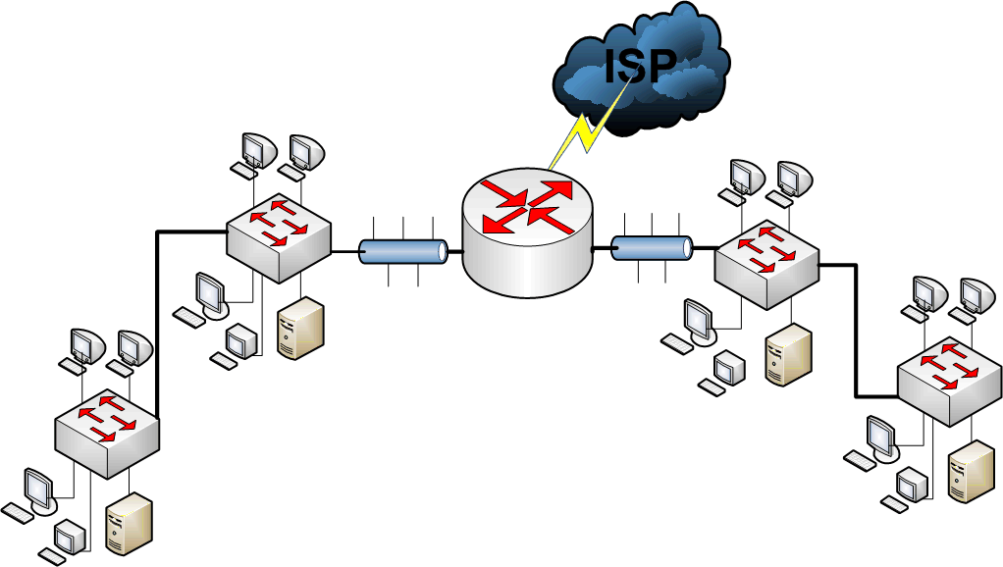
Example 1 - 200.1.1.0
Scenario:
Company office has 150 nodes on one network
Requires security for a new business unit (50 nodes)
Need to improve performance on the overall network
Subnet using the main router.

Slide 18
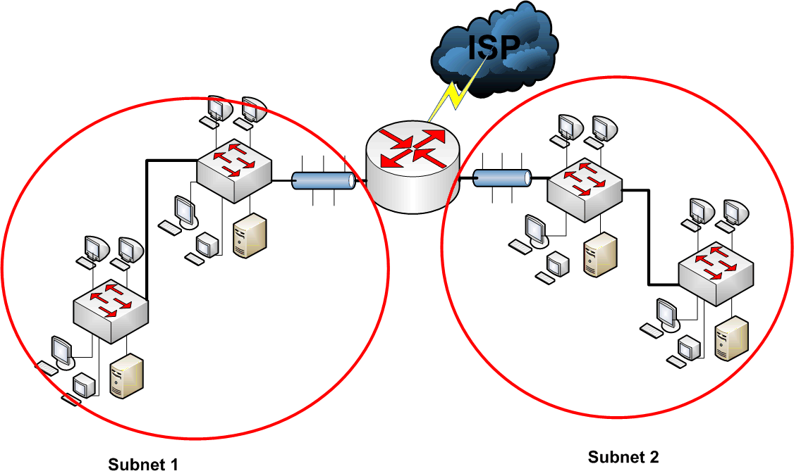
Example 1 - 200.1.1.0
Subnet # | Subnet ID | Host Range | Broadcast ID
0 | 200.1.1.0 | 200.1.1.1 - .126 | 200.1.1.127
1 | 200.1.1.128 | 200.1.1.129 - .254 | 200.1.1.255
We need two subnets
So, we borrow 1 bit, as 2¹ = 2
Which leaves 7 host bits, for 2⁷ = 128 addresses per subnet

